Slide 1
References
Software Engineering
  Ian Sommerville 8th Edition
Software Engineering
  A Practitioner Approach
    Roger S Pressman

Slide 2
Outline of this presentation
The Origin of Software Engineering
Historical Aspects of Software Engineering
Economic Aspect of Software Engineering
Scope of Software Engineering
What is Software

Slide 3
Historical Aspect of Software Engineering
1968/69 NATO conferences: introduction of the term Software Engineering
Idea: software development is not an art, or a bag of tricks
Build Software should be an engineering like activity
    Build software like we build bridges

Slide 4
Economic Aspect of Software Engineering
Software Engineering v.s. Computer Science
  The computer scientist investigates several ways to produce software, some good and some bad.
  But the software engineer is interested in only those techniques that make sound economic sense.

Slide 5
Economic Aspect of Software Engineering
For example:
A coding technique that can execute very efficiently but with higher maintenance cost may not be a good choice.

Slide 6
Scope of Software Engineering
Software engineering is a discipline whose aim is the production of fault-free software, that is delivered on time, within budget, and satisfies the user’s needs.

Slide 7
Scope of Software Engineering
IEEE Definition of Software Engineering
Software Engineering is the application of a systematic, disciplined, quantifiable approach to the development, operation, and maintenance of software; that is, the application of engineering to software
Notes:
Rekayasa Perangkat Lunak adalah aplikasi yang sistematis, disiplin, pendekatan kuantitatif untuk pengembangan, operasi, dan pemeliharaan perangkat lunak; yaitu penerapan rekayasa perangkat lunak

Slide 8
Scope of Software Engineering
Software Engineering is the:
application of engineering to software

Slide 9
Scope of Software Engineering
Software Life Cycle / Software Process
    Requirements Phase
    Specification (Analysis) Phase
    Planning Phase
    Design Phase
    Implementation Phase
    Integration Phase
    Maintenance Phase (highest cost)
    Retirement
Notes:
Spesifikasi (Analisa) Tahap
Tahap perencanaan
Tahap desain
Tahap implementasi
Tahap integrasi
Fase Pemeliharaan (biaya tertinggi)
pensiun

Slide 10
Scope of Software Engineering
Maintenance is so important, a major aspect of software engineering consists of techniques, tools, and practices that lead to a reduction in maintenance cost.
Requirement 2%
Specification 4%
Planning 1%
Design 6%
Maintenance
67%
Module Coding 5%
Maintenance
67%
Module Testing 7%
Integration 8%
Maintenance 67%
FAKULTAS TEKNOLOGI INFORMASI
REKAYASA PERANGKAT LUNAK – KP146 – 3 SKS – BAG 1
Notes:
Pemeliharaan sangat penting, aspek utama rekayasa perangkat lunak terdiri dari teknik, alat-alat, dan praktik-praktik yang mengarah pada pengurangan dalam biaya pemeliharaan

Slide 11

Scope of Software Engineering
Why does software maintenance cost so much?

Slide 12
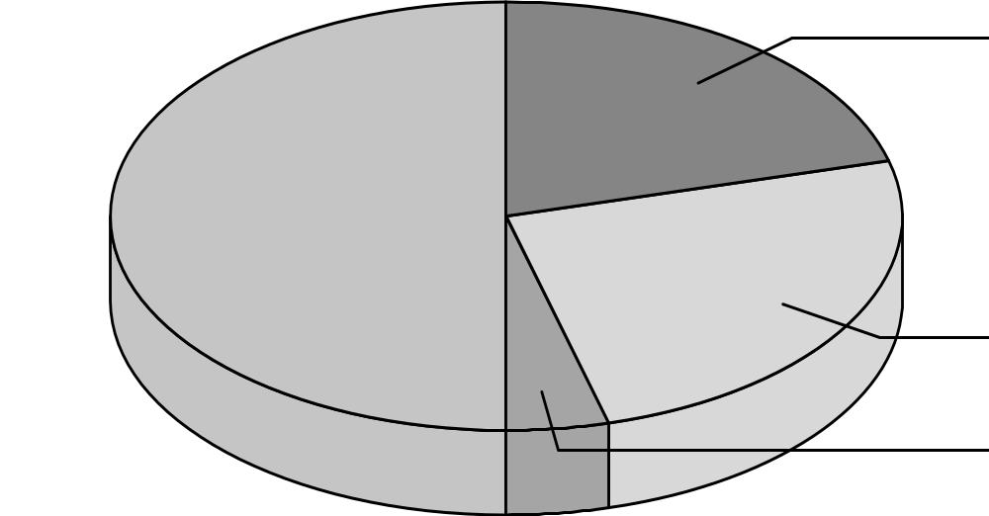
Scope of Software Engineering
Kind of Maintenance
corrective
21%
perfective
50%
25%
adaptive
preventive
4%

Slide 13
Scope of Software Engineering
Maintenance
  corrective maintenance correcting errors
  adaptive maintenance adapting to changes in the environment (both hardware and software)
  perfective maintenance adapting to changing user requirements
  preventive maintenance keeping in good state
Notes:
pemeliharaan mengoreksi kesalahan korektif
adaptif pemeliharaan beradaptasi terhadap perubahan lingkungan (baik hardware dan software)
perfektif pemeliharaan beradaptasi terhadap perubahan kebutuhan pengguna
menjaga pemeliharaan preventif dalam kondisi baik

Slide 14
What is Software ?
Computer programs +
Configuration data and files +
User and system documentation.
    Install
    Use
    Design
    Maintain
FAKULTAS TEKNOLOGI INFORMASI
REKAYASA PERANGKAT LUNAK – KP146 – 3 SKS – BAG 1

Slide 15
Documentation
Install
  How to Install
Use
  User Guide
Design
  What the system consist of
Maintain
  Maintenance History
For
User
For
Developer

Slide 16
Documentation
Install
  How to Install
    Specification of H/W,
    Specification of S/W,
    Environment Condition
    etc

Slide 17
Documentation
Use
  User Guide
    How to Use the Software
      Login?
      Inquiry Procedure
      Error Recovery
      etc
FAKULTAS TEKNOLOGI INFORMASI
REKAYASA PERANGKAT LUNAK – KP146 – 3 SKS – BAG 1

Slide 18
Documentation
Design
  What the system consist of
    Model
      Functionality
      Interface
      Repository
      etc
FAKULTAS TEKNOLOGI INFORMASI
REKAYASA PERANGKAT LUNAK – KP146 – 3 SKS – BAG 1

Slide 19
Documentation
Maintain
  Maintenance History
    How are the changes
    Correction
    Permission
    Revision
    Edition
    etc
FAKULTAS TEKNOLOGI INFORMASI
REKAYASA PERANGKAT LUNAK – KP146 – 3 SKS – BAG 1

